Slide 1
Digital Logic Design
Spring 2021
(AMD X4 Proc; photo: Sc. Am, Jan. 2010)

Slide 2
Course Description
This course provides a modern introduction to logic design and the basic building blocks used in digital systems, in particular digital computers.
It starts with a discussion of combinational logic: logic gates, minimization techniques, arithmetic circuits, and modern logic devices such as field programmable logic gates.
The second part of the course deals with sequential circuits: flip-flops, synthesis of sequential circuits, and case studies, including counters, registers, and random access memories.
State machines will then be discussed and illustrated through case studies of more complex systems using programmable logic devices. Different representations including truth table, logic gate, timing diagram, switch representation, and state diagram will be discussed.

Slide 3
Course Logistics
Textbook:
"Digital Design: With an Introduction to the Verilog HDL”
M. M. Mano, M. D. Ciletti), 5th ed., Prentice Hall.
Reference Text Book:
"Logic and Computer Design Fundamentals," , by M. Mano and C. Kime,

Slide 4
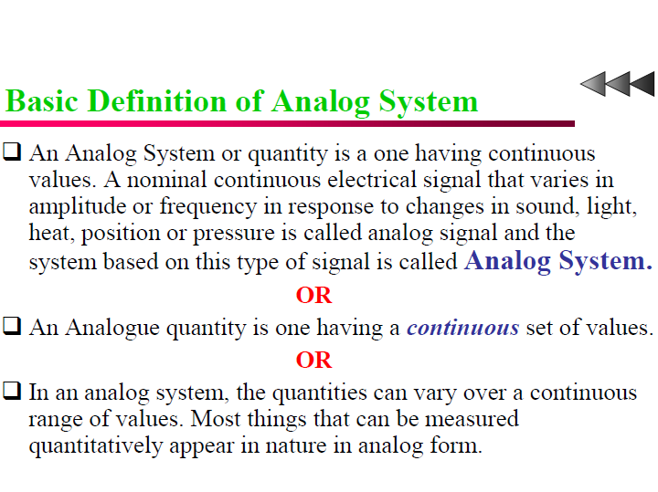

Slide 5
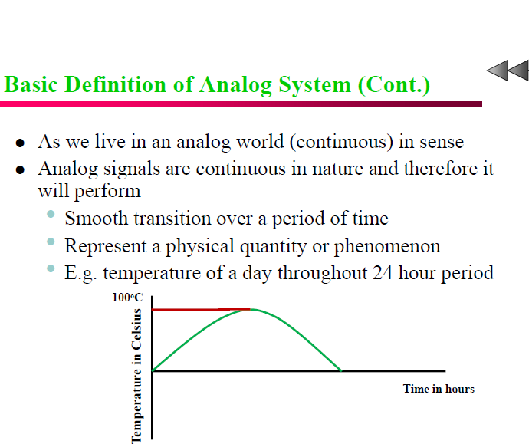

Slide 6
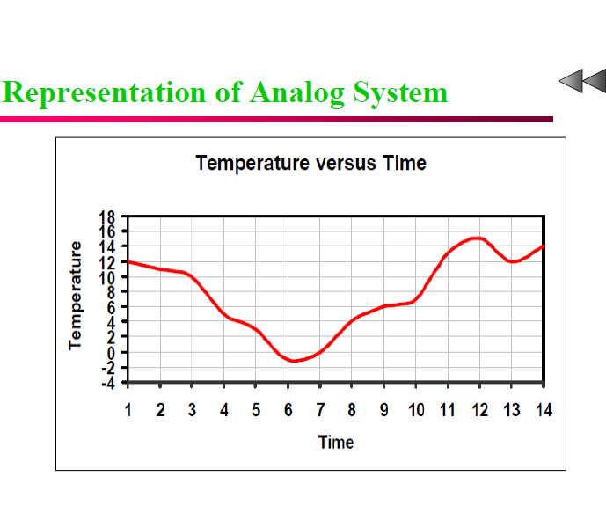

Slide 7
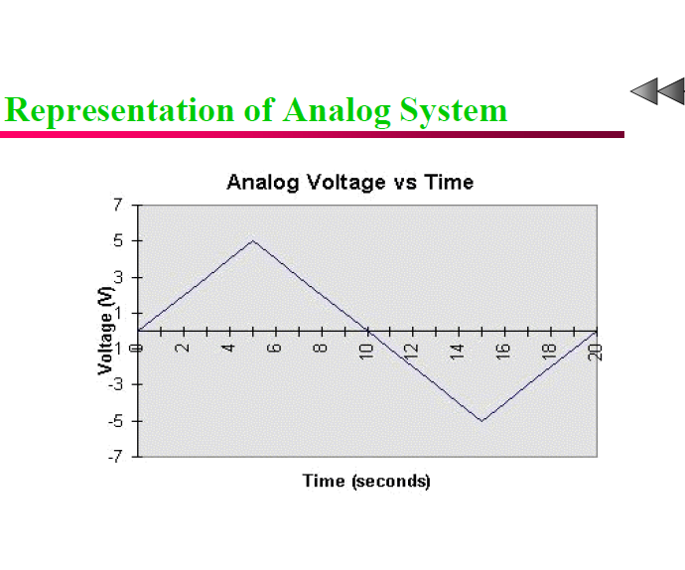

Slide 8
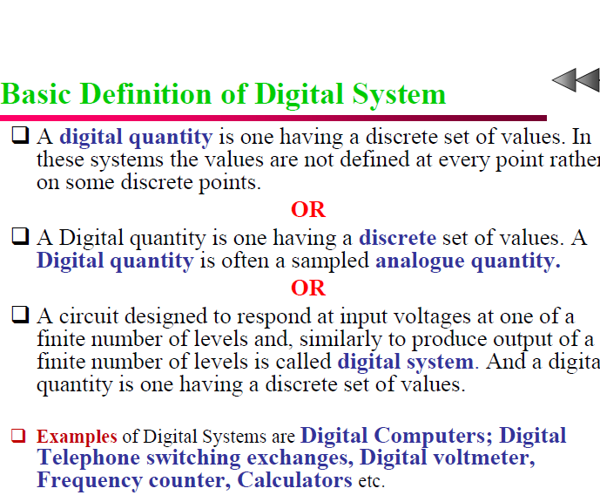

Slide 9
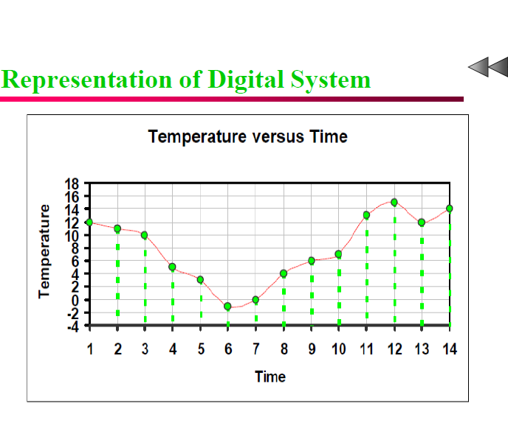

Slide 10
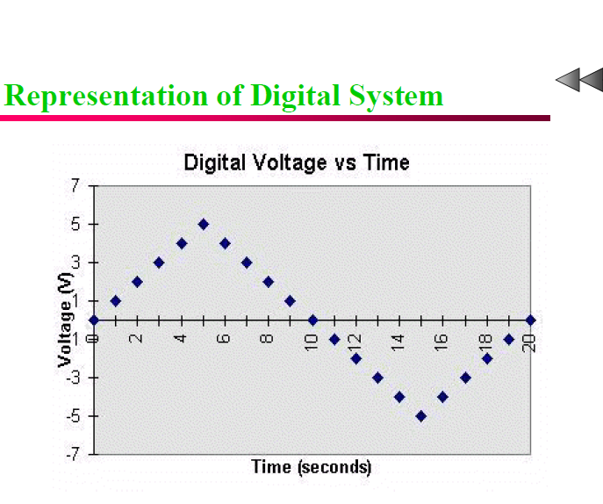

Slide 11
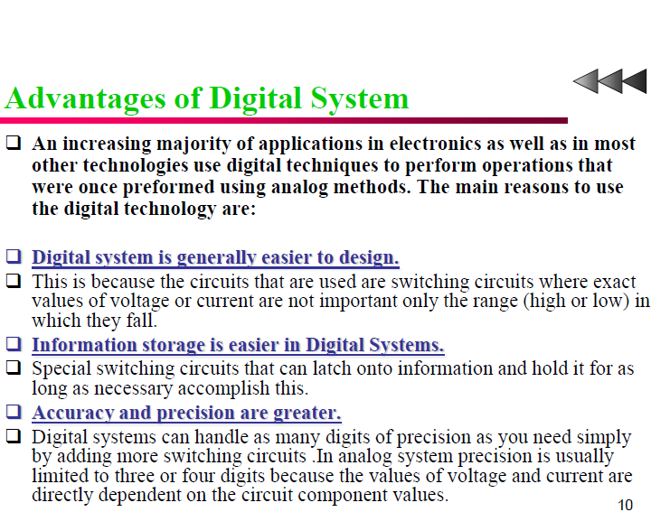

Slide 12
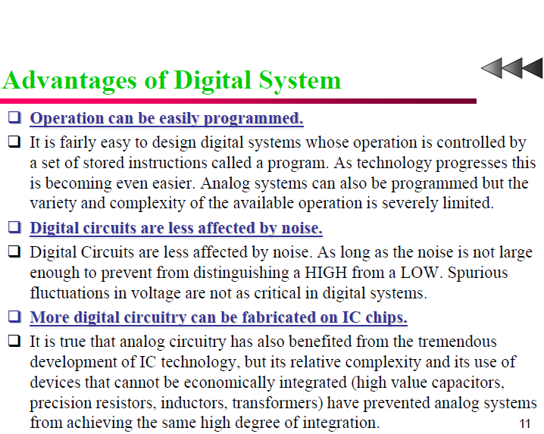

Slide 13
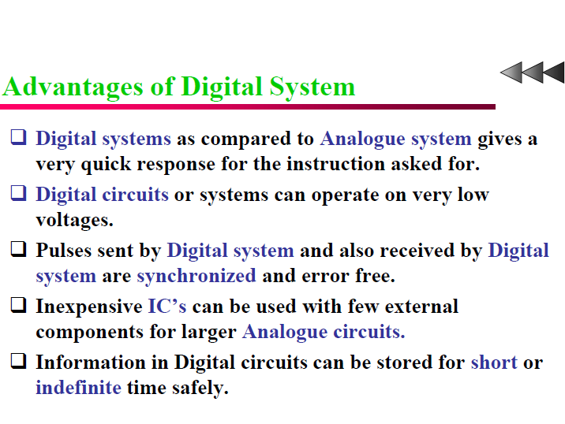

Slide 14
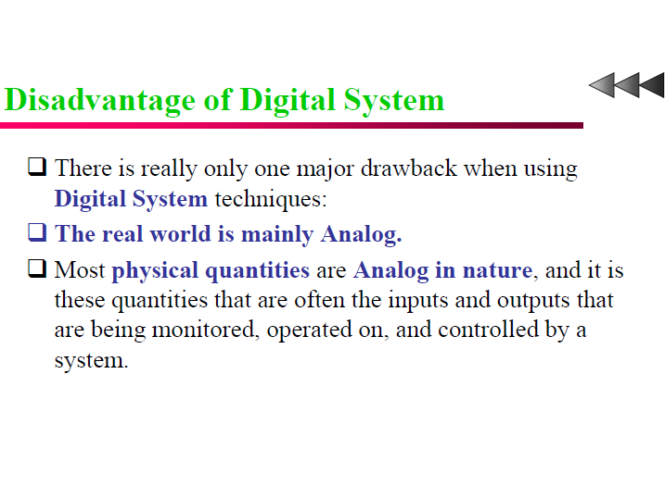

Slide 15
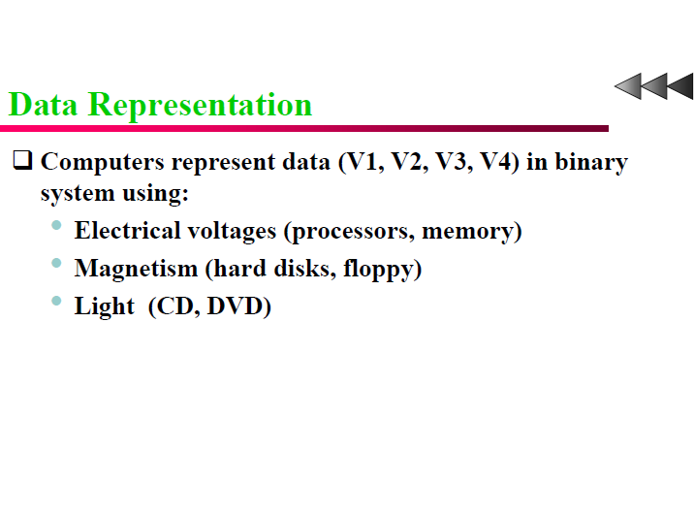

Slide 16
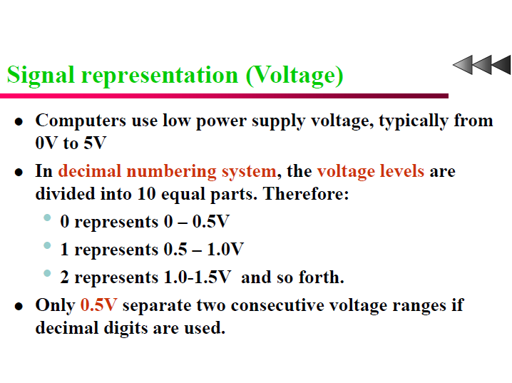

Slide 17
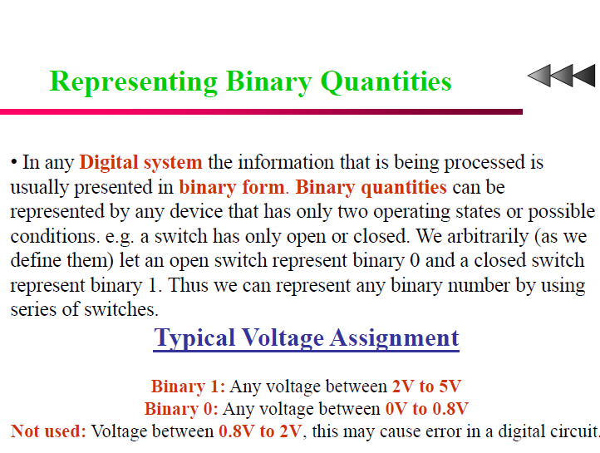

Slide 18
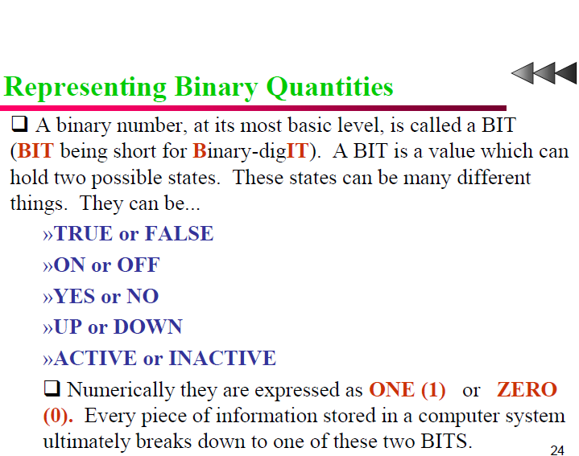

Slide 19
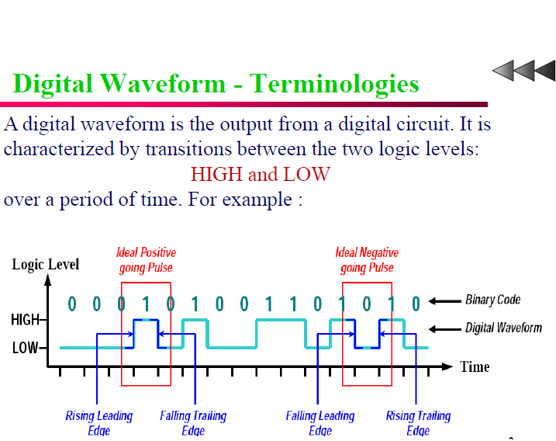

Slide 20
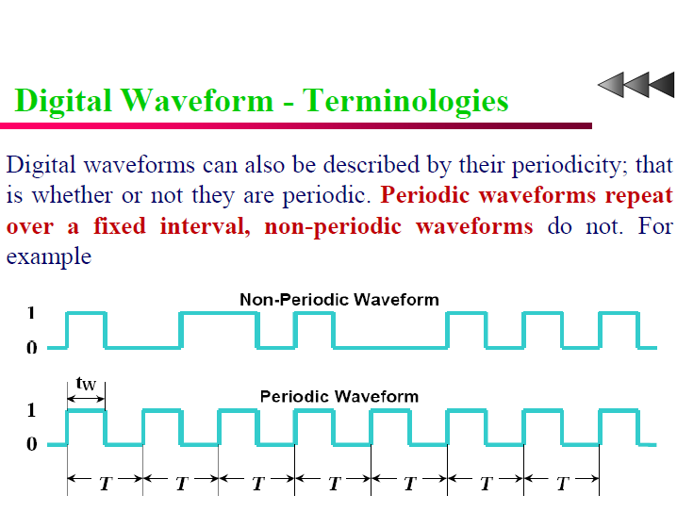

Slide 21
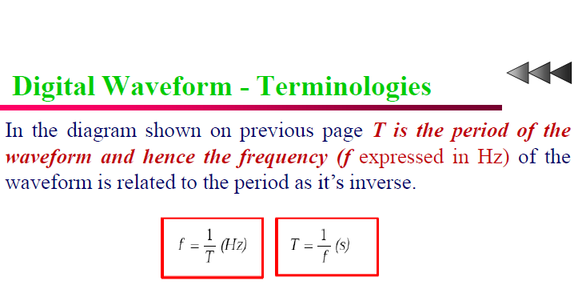

Slide 22
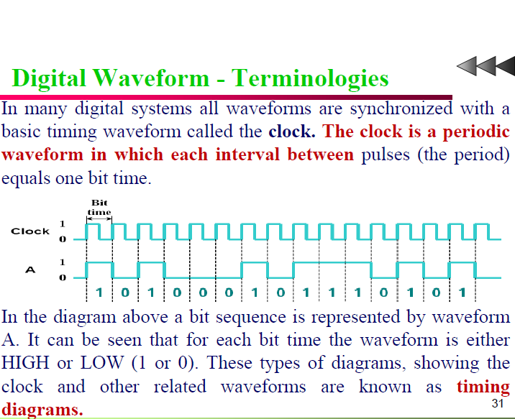

Slide 23
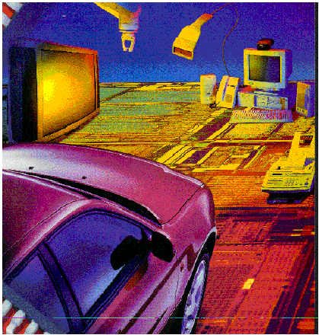
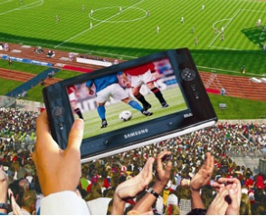

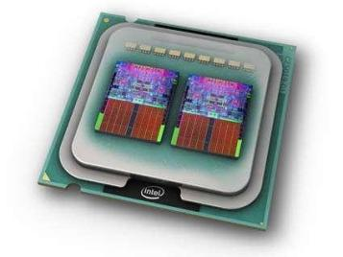
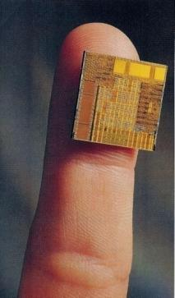
Digital Circuits are Everywhere
Communications
Multi-media
Manufacturing
Consumer electronics
Health care
Defense and security
Software
Automotive, etc
(Source: R. Tummala, IEEE Spectrum, June 2006)

Slide 24

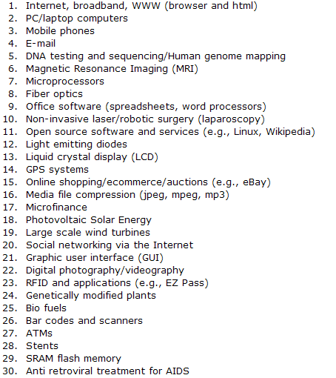
Life Changers
Of these 30 innovations , 10 are directly related to advances in Digital Logic and Solid State Circuits;
Another 8 are the indirect results of ICs.
See artilcel at: http://knowledge.wharton.upenn.edu/article.cfm?articleid=2163
Notes:
Nightly business report on PBS: Top innovations of the last 30 yrs, according to judges at the Univ. of Pennsylvania’s Wharton School

Slide 25
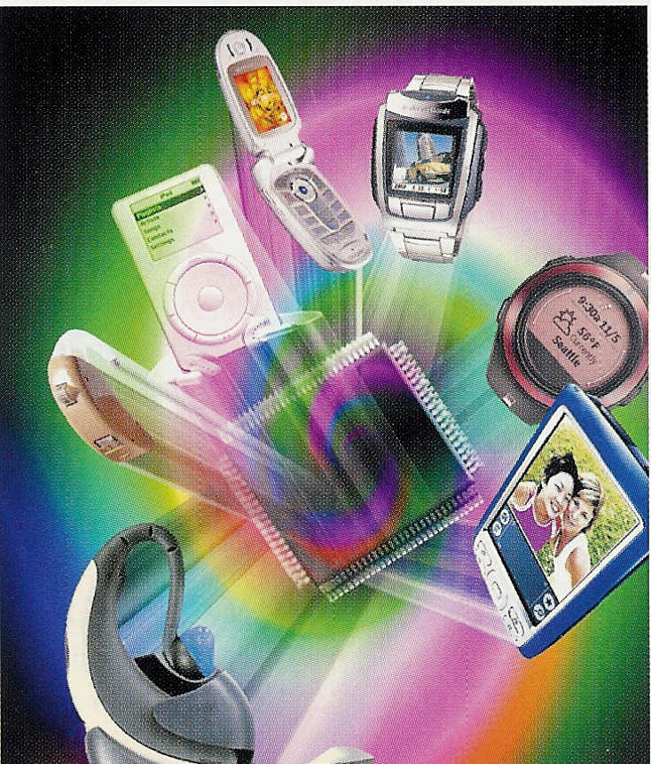
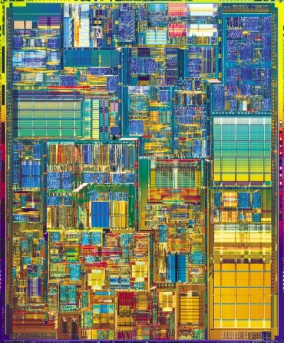

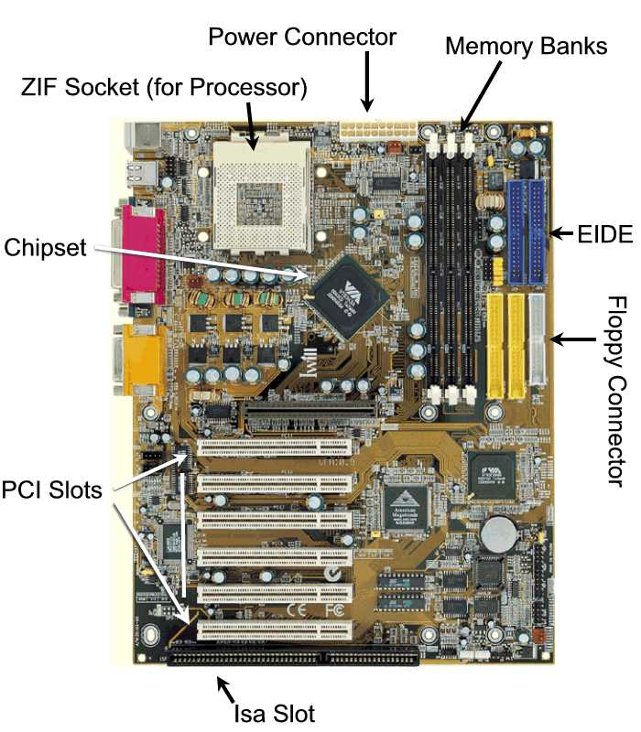
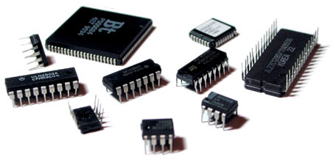
Deals with building blocks of digital systems
?
(Intel)
EE Times, Berkeley Design Tech.
(D. Rommel)
Notes:
PCI: Peripheral Component Interconnect
ISA: Industrial Standard Architecture
EIDE (Enhanced Integrated Drive Electronics: connects that connect cables for Hard drives, Floppy drives.

Slide 26
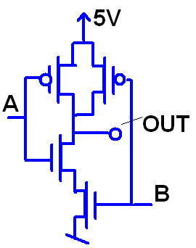
What are Logic Gates built from?
Transistors:
The transistor is the workhorse of every electronic device.
Transistor
Digital building blocks

Slide 27
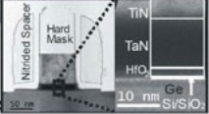
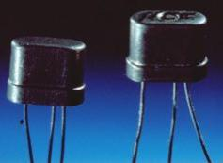
What is a Transistor?
Electronic, solid-state device that can amplify an electric signal:
V_{out} > V_{in}
Power_{out} > Power_{in}
in
S
out
transistor
B
(Source: IMEC)
Id
output
input
Mike

Slide 28
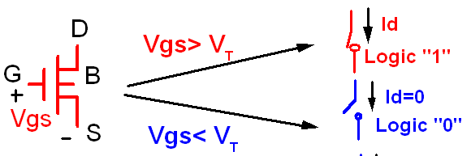
Digital Model of a Transistor
We make abstraction of the signals: 0 or 1
As a result a transistors can be considered a switch (on or off; 1 or ;):

Slide 29
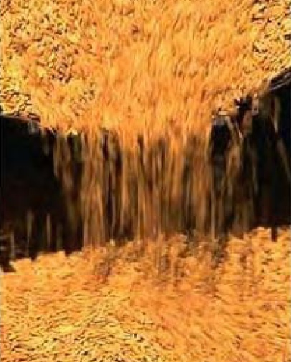
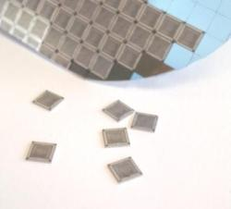
Ten quintillion
Ten quintillion: 10x10¹⁸
Is about the number grains of rice harvested in 2004
Number of transistors fabricated in 2004
In 2008: 1B transistors fabricated/capita

Slide 30

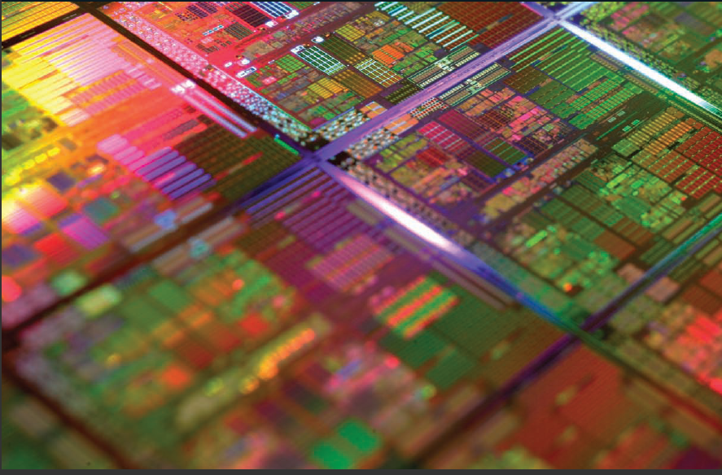
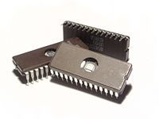
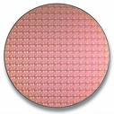
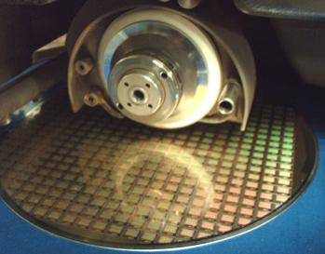
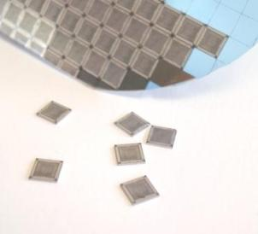
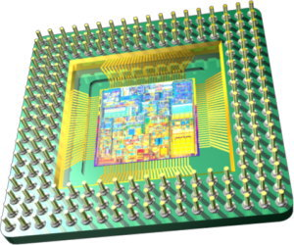
What is an IC?
An Integrated Circuit is a miniaturized electronic circuits whose components (transistors, resistors, capacitors) are build on the surface of a semiconductor wafer, using the same planar fabrication technology.
(Source: http://www.majelac.com/images/wafer_dicing.jpg)
(Source: Wikipedia)
(Picture: Scientific American, Jan. 2010)

Slide 31
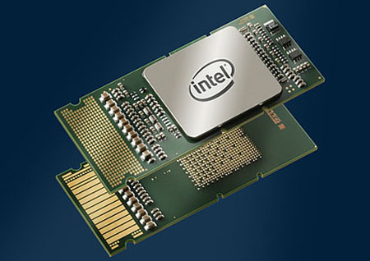
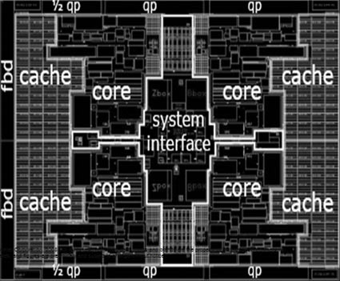
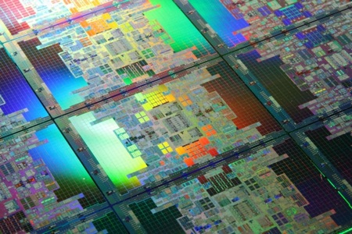
Intel Itanium 9300 Tukwila Processor
(source: www.tgdaily.com)
Four cores
Over 2 billion transistors!

Slide 32


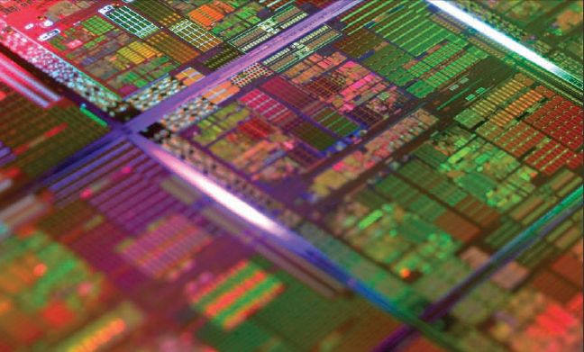
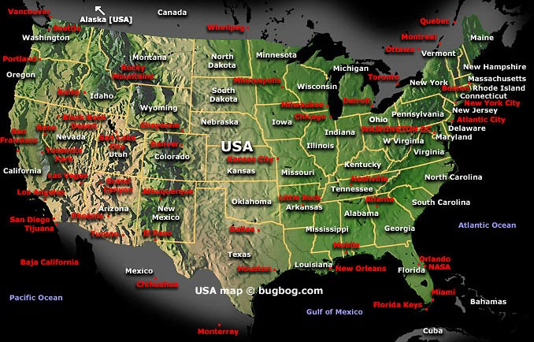
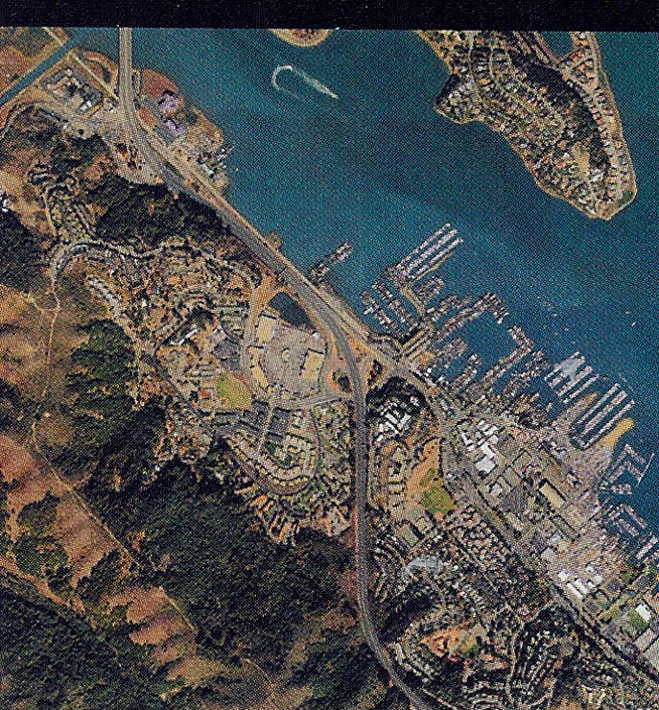
Chip complexity
Complexity of the USA
(AMD X4 Proc: 758 million transistors; photo: Sc. Am, Jan. 2010)
Submicron and nanoscale dimensions
Compare to a street map

Slide 33
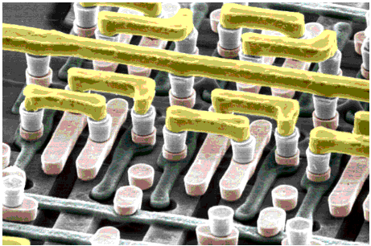
World of the Small
Circuit Level
5 layers of interconnections
Chip level
(VLSI)
(IBM Corp.)
Logic Level

Slide 34


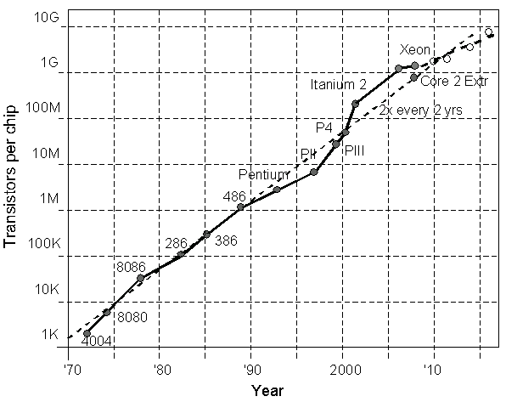
Moore’s Law
Chip complexity doubles every two years
First 2-Billion Trans. Processor (Tukwila: Itanium processor); Production Q1, 2010

Slide 35
1. Number Systems

Slide 36
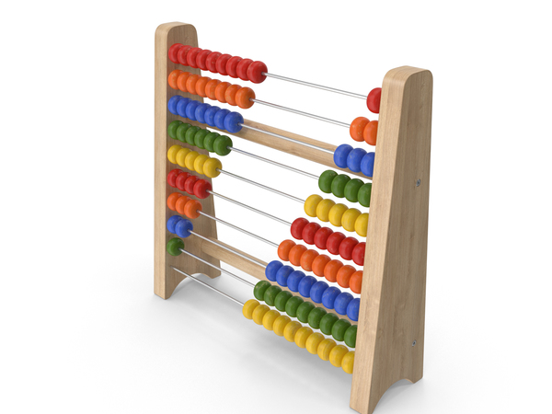
Notes:
https://www.sliderulemuseum.com/Abaci/THE_ABACUS_HANDBOOK.pdf

Slide 37
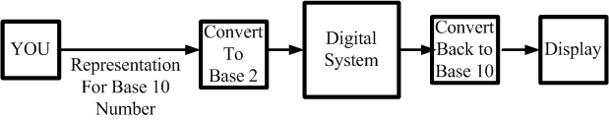
Human perception
We naturally live in a base 10 environment
Computer exist in a base 2 environment
So give the computer/digital system the task of doing the conversions for us.

Slide 38
Binary Codes
“An n-bit binary code is a group of n bits that assume up to 2^{n} distinct combinations of 1s and 0s, with each combination representing one element of the set being coded”
For the 10 digits need a 4 bit code. One code is called Binary Coded Decimal (BCD)

Slide 39
There are 10 kinds of people in the world:
those who understand binary numerals, and
those who don't.

Slide 40
Decimal and BCD
The BCD is simply the 4 bit representation of the decimal digit.
For multiple digit base 10 numbers, each symbol is represented by its BCD digit
What happened to 6 digits not used?

Slide 41
Common Number Systems
System | Base | Symbols | Used by humans? | Used in computers?
Decimal | 10 | 0, 1, … 9 | Yes | No
Binary | 2 | 0, 1 | No | Yes
Octal | 8 | 0, 1, … 7 | No | No
Hexa- decimal | 16 | 0, 1, … 9, A, B, … F | No | No

Slide 42
Quantities/Counting (1 of 3)
Decimal | Binary | Octal | Hexa- decimal
0 | 0 | 0 | 0
1 | 1 | 1 | 1
2 | 10 | 2 | 2
3 | 11 | 3 | 3
4 | 100 | 4 | 4
5 | 101 | 5 | 5
6 | 110 | 6 | 6
7 | 111 | 7 | 7
p. 33

Slide 43
Quantities/Counting (2 of 3)
Decimal | Binary | Octal | Hexa- decimal
8 | 1000 | 10 | 8
9 | 1001 | 11 | 9
10 | 1010 | 12 | A
11 | 1011 | 13 | B
12 | 1100 | 14 | C
13 | 1101 | 15 | D
14 | 1110 | 16 | E
15 | 1111 | 17 | F

Slide 44
Quantities/Counting (3 of 3)
Decimal | Binary | Octal | Hexa- decimal
16 | 10000 | 20 | 10
17 | 10001 | 21 | 11
18 | 10010 | 22 | 12
19 | 10011 | 23 | 13
20 | 10100 | 24 | 14
21 | 10101 | 25 | 15
22 | 10110 | 26 | 16
23 | 10111 | 27 | 17
Etc.

Slide 45
Conversion - Summary
Divisions by 16
∑A_{i}.16^{i}
Hexadecimal
Decimal
Divisons by 2
ΣA_{i}.2^{i}
Group in bits of 4
Binary
Divisions by 8
Octal ↔Hex: through the binary representation
Group in bits of 3
∑ A_{i}.8^{i}
Octal

Slide 46
Conversion Among Bases
The possibilities:
Decimal
Octal
Binary
Hexadecimal
pp. 40-46

Slide 47
Quick Example
25₁₀ = 11001₂ = 31₈ = 19₁₆
Base

Slide 48
Decimal to Decimal (just for fun)
Decimal
Octal
Binary
Hexadecimal
Next slide…

Slide 49
Weight
125₁₀ => 5 x 10⁰ = 5 2 x 10¹ = 20 1 x 10² = 100 125
Base

Slide 50
Binary to Decimal
Decimal
Octal
Binary
Hexadecimal

Slide 51
Binary to Decimal
Technique
Multiply each bit by 2^{n}, where n is the “weight” of the bit
The weight is the position of the bit, starting from 0 on the right
Add the results

Slide 52
Example
Bit “0”
101011₂ => 1 x 2⁰ = 1 1 x 2¹ = 2 0 x 2² = 0 1 x 2³ = 8 0 x 2⁴ = 0 1 x 2⁵ = 32
43₁₀

Slide 53
Octal to Decimal
Decimal
Octal
Binary
Hexadecimal

Slide 54
Octal to Decimal
Technique
Multiply each bit by 8^{n}, where n is the “weight” of the bit
The weight is the position of the bit, starting from 0 on the right
Add the results

Slide 55
Example
724₈ => 4 x 8⁰ = 4 2 x 8¹ = 16 7 x 8² = 448 468₁₀

Slide 56
Hexadecimal to Decimal
Decimal
Octal
Binary
Hexadecimal

Slide 57
Hexadecimal to Decimal
Technique
Multiply each bit by 16^{n}, where n is the “weight” of the bit
The weight is the position of the bit, starting from 0 on the right
Add the results

Slide 58
Example
ABC₁₆ => C x 16⁰ = 12 x 1 = 12 B x 16¹ = 11 x 16 = 176 A x 16² = 10 x 256 = 2560
2748₁₀

Slide 59
Decimal to Binary
Decimal
Octal
Binary
Hexadecimal

Slide 60
Decimal to Binary
Technique
Divide by two, keep track of the remainder
First remainder is bit 0 (LSB, least-significant bit)
Second remainder is bit 1
Etc.

Slide 61
Example
125₁₀ = ?₂
2 125 62 1
2 31 0
2 15 1
2 7 1
2 3 1
2 1 1
2 0 1
125₁₀ = 1111101₂

Slide 62
Octal to Binary
Decimal
Octal
Binary
Hexadecimal

Slide 63
Octal to Binary
Technique
Convert each octal digit to a 3-bit equivalent binary representation

Slide 64
Example
705₈ = ?₂
7 0 5
111 000 101
705₈ = 111000101₂

Slide 65
Hexadecimal to Binary
Decimal
Octal
Binary
Hexadecimal

Slide 66
Hexadecimal to Binary
Technique
Convert each hexadecimal digit to a 4-bit equivalent binary representation

Slide 67
Example
10AF₁₆ = ?₂
1 0 A F
0001 0000 1010 1111
10AF₁₆ = 0001000010101111₂

Slide 68
Decimal to Octal
Decimal
Octal
Binary
Hexadecimal

Slide 69
Decimal to Octal
Technique
Divide by 8
Keep track of the remainder

Slide 70
Example
1234₁₀ = ?₈
8 1234
154 2
8
19 2
8
2 3
8
0 2
1234₁₀ = 2322₈

Slide 71
Decimal to Hexadecimal
Decimal
Octal
Binary
Hexadecimal

Slide 72
Decimal to Hexadecimal
Technique
Divide by 16
Keep track of the remainder

Slide 73
Example
1234₁₀ = ?₁₆
16 1234
77 2
16
4 13 = D
16
0 4
1234₁₀ = 4D2₁₆

Slide 74
Binary to Octal
Decimal
Octal
Binary
Hexadecimal

Slide 75
Binary to Octal
Technique
Group bits in threes, starting on right
Convert to octal digits

Slide 76
Example
1011010111₂ = ?₈
1 011 010 111
1 3 2 7
1011010111₂ = 1327₈

Slide 77
Binary to Hexadecimal
Decimal
Octal
Binary
Hexadecimal

Slide 78
Binary to Hexadecimal
Technique
Group bits in fours, starting on right
Convert to hexadecimal digits

Slide 79
Example
1010111011₂ = ?₁₆
10 1011 1011
B B
1010111011₂ = 2BB₁₆

Slide 80
Octal to Hexadecimal
Decimal
Octal
Binary
Hexadecimal

Slide 81
Octal to Hexadecimal
Technique
Use binary as an intermediary

Slide 82
Example
1076₈ = ?₁₆
1 0 7 6
001 000 111 110
2 3 E
1076₈ = 23E₁₆

Slide 83
Hexadecimal to Octal
Decimal
Octal
Binary
Hexadecimal

Slide 84
Hexadecimal to Octal
Technique
Use binary as an intermediary

Slide 85
Example
1F0C₁₆ = ?₈
1 F 0 C
0001 1111 0000 1100
1 7 4 1 4
1F0C₁₆ = 17414₈

Slide 86
Exercise – Convert ...
Decimal | Binary | Octal | Hexa- decimal
33
 | 1110101
 |  | 703
 |  |  | 1AF
Don’t use a calculator!

Slide 87
Common Powers (1 of 2)
Base 10
Power | Preface | Symbol
10⁻¹² | pico | p
10⁻⁹ | nano | n
10⁻⁶ | micro | μ
10⁻³ | milli | m
10³ | kilo | k
10⁶ | mega | M
10⁹ | giga | G
10¹² | tera | T
Value
.000000000001
.000000001
.000001
.001
1000
1000000
1000000000
1000000000000

Slide 88
Common Powers (2 of 2)
Base 2
Power | Preface | Symbol
2¹⁰ | kilo | k
2²⁰ | mega | M
2³⁰ | Giga | G
Value
1024
1048576
1073741824
What is the value of “k”, “M”, and “G”?
In computing, particularly w.r.t. memory, the base-2 interpretation generally applies

Slide 89

Example
In the lab… 1. Double click on My Computer 2. Right click on C: 3. Click on Properties
/ 2³⁰ =

Slide 90
Review – multiplying powers
For common bases, add powers
a^{b} × a^{c} = a^{b+c}
2⁶ × 2¹⁰ = 2¹⁶ = 65,536
or…
2⁶ × 2¹⁰ = 64 × 2¹⁰ = 64k

Slide 91
Binary Addition (1 of 2)
Two 1-bit values
A | B | A + B
0 | 0 | 0
0 | 1 | 1
1 | 0 | 1
1 | 1 | 10
“two”
pp. 36-38

Slide 92
Binary Addition (2 of 2)
Two n-bit values
Add individual bits
Propagate carries
E.g.,
1
1
10101 21 + 11001 + 25 101110 46

Slide 93
Multiplication (1 of 3)
Decimal (just for fun)
35 x 105 175 000 35 3675
pp. 39

Slide 94
Multiplication (2 of 3)
Binary, two 1-bit values
A | B | A × B
0 | 0 | 0
0 | 1 | 0
1 | 0 | 0
1 | 1 | 1

Slide 95
Multiplication (3 of 3)
Binary, two n-bit values
As with decimal values
E.g.,
1110 x 1011 1110 1110 0000 1110 10011010

Slide 96
Fractions
Decimal to decimal (just for fun)
3.14 => 4 x 10⁻² = 0.04 1 x 10⁻¹ = 0.1 3 x 10⁰ = 3 3.14
pp. 46-50

Slide 97
Fractions
Binary to decimal
10.1011 => 1 x 2⁻⁴ = 0.0625 1 x 2⁻³ = 0.125 0 x 2⁻² = 0.0 1 x 2⁻¹ = 0.5 0 x 2⁰ = 0.0 1 x 2¹ = 2.0 2.6875
pp. 46-50

Slide 98
Fractions
.14579 x 2 0.29158 x 2 0.58316 x 2 1.16632 x 2 0.33264 x 2 0.66528 x 2 1.33056
etc.
Decimal to binary
3.14579
11.001001...
p. 50

Slide 99
Exercise – Convert ...
Decimal | Binary | Octal | Hexa- decimal
29.8
 | 101.1101
 |  | 3.07
 |  |  | C.82
Don’t use a calculator!
Answer

Slide 100
Conversion - Summary
Divisions by 16
∑A_{i}.16^{i}
Hexadecimal
Decimal
Divisons by 2
ΣA_{i}.2^{i}
Group in bits of 4
Binary
Divisions by 8
Octal ↔Hex: through the binary representation
Group in bits of 3
∑ A_{i}.8^{i}
Octal

Slide 101
Binary Arithmetic

Slide 102


Slide 103


Slide 104


Slide 105


Slide 106


Slide 107


Slide 108


Slide 109


Slide 110


Slide 111


Slide 112


Slide 113


Slide 114


Slide 115


Slide 116


Slide 117


Slide 118


Slide 119


Slide 120


Slide 121


Slide 122


Slide 123


Slide 124


Slide 125


Slide 126


Slide 127


Slide 128


Slide 129


Slide 130


Slide 131


Slide 132


Slide 133


Slide 134


Slide 135


Slide 136


Slide 137


Slide 138


Slide 139


Slide 140


Slide 141


Slide 142
Codes

Slide 144

BCD

Slide 145

BCD

Slide 146

BCD

Slide 147

BCD

Slide 148

BCD Addition

Slide 149

BCD Additions

Slide 150

Invalid Case

Slide 151

BCD Addition Example

Slide 152

BCD Addition Example

Slide 153

BCD Addition Example

Slide 154

Codes

Slide 155

GRAY Codes

Slide 156


Slide 157

Binary to Gray Code Conversion

Slide 158

Binary to Gray Code Conversion

Slide 159

Binary to Gray Code Conversion

Slide 160

Binary to Gray Code Conversion

Slide 161


Slide 162

ASCII

Slide 163

ASCII

Slide 164


Slide 165

ASCII

Slide 166


